Slide 1

INVESTIGATION OF SURFACE INTEGRITY OF POWDER MIXED EDM OF NICKEL-BASED SUPER ALLOY USING CHROMIUM POWDER
Team members :
K. Bhaswanth, 124009059
B. Chanakya Reddy, 124009284
P. V. S. Praneeth, 124009142
Guide:
Ramesh. S
Assistant Professor - 3
Design and Analysis.

Slide 2
OVERVIEW
Introduction
Problem Statement
Objective
Literature Survey
Methodology
Results
References

Slide 3
INTRODUCTION:
EDM – ELECTRIC DISCHARGE MACHINING.
What is EDM?
Electric Discharge Machining is the process of metal removal from the work surface due to an erosion of metal caused by electric spark discharge between the two electrodes tool(cathode) and the work(Anode).

Slide 4
PROBLEM STATEMENT:
By setbacks of EDM process like poor Surface roughness, Low material removal rate. We decided to select Powder Mixed EDM process.
To get better Surface roughness, Micro Hardness, using Chromium Powder on Nickel based Super Alloy (Nimonic75).

Slide 5
OBJECTIVE:
To investigate the Powder Mixed EDM process on Nickel based Super alloy (Nimonic75) with Chromium Powder, with considering the process parameters concentration of powder, peak current, Pulse on time. To know about
Surface roughness.
Micro Hardness.
Structure Analysis.

Slide 6
LITERATURE SURVEY:
Anand Y. Joshi
To understand the PMEDM concept and process parameters in the process to achieve better quality levels.
It improves material removal rate and reducing tool wear rate, mirror like surface finish, no burrs.
Dr. Ramesh
to study the influence of different tool materials on powder mixed EDM of nickel based super alloy Nimonic75 with three different powders( Zn, Co, Mo).
Zn &Co produced better MRR, Mo produces low tool wear rate &low surface roughness.
Pragya shandilya
Machining of nimonic90 by PMEDM by adding silicone powder to kerosene oil to improve the machining rate and surface quality. And parameters are S_{OFF} S_{ON} I_{P} P_{C}
For surface roughness S_{ON} was the most significant parameter followed by I_{P} P_{C}

Slide 7
METHODOLOGY FOR SURFACE ROUGHNESS
Do Powder Mixed EDM machining on 15 work pieces, with certain parameter levels of concentration of powder, peak current, pulse on time (Ton)
Measure the surface roughness values from surface roughness measuring machine.
Draw the graphs of surface roughness with parameters concentration of powder, peak current, pulse on time(Ton).
Check whether the surface roughness is decreased or not when powder is mixed.

Slide 8
METHODOLOGY FOR MICRO HARDNESS
Do Powder Mixed EDM Machining on 15 work pieces with certain parameter levels of concentration of powder, peak current, pulse on time(Ton).
Measure the Micro Hardness values using Micro Vickers Hardness Machine.
Draw the graphs of Micro Hardness values with parameters concentration of powder, peak current, pulse on time(Ton).
Check whether the Hardness of the work piece is increased or not when powder is mixed.

Slide 9
RESULTS
Parameters Level:
Parameters | Level 1 | Level 2 | Level 3
Concentration (g/l) | 0 | 3 | 6
Discharge current (A) | 2 | 4 | 6
Pulse on Time (μs) | 10 | 30 | 50

Slide 10
SURFACE ROUGHNESS VALUES:
Concentration of powder | Peak current | Pulse on time (Ton) | Surface roughness
0 | 2 | 30 | 2.51
0 | 4 | 10 | 3.14
0 | 4 | 50 | 3.19
0 | 6 | 30 | 3.65
3 | 2 | 10 | 2.02
3 | 2 | 50 | 2.30
3 | 4 | 30 | 2.67
3 | 4 | 30 | 2.68
3 | 4 | 30 | 2.64
3 | 6 | 10 | 3.11
3 | 6 | 50 | 3.34
6 | 2 | 30 | 2.19
6 | 4 | 10 | 2.46
6 | 4 | 50 | 2.67
6 | 6 | 30 | 2.73

Slide 11
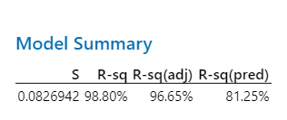
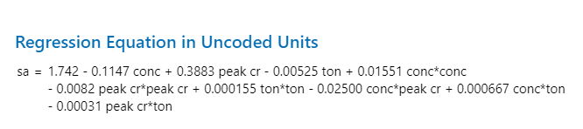
MODEL SUMMARY OF SURFACE ROUGHNESS
REGRESSION EQUATION FOR SURFACE HARDNESS

Slide 12
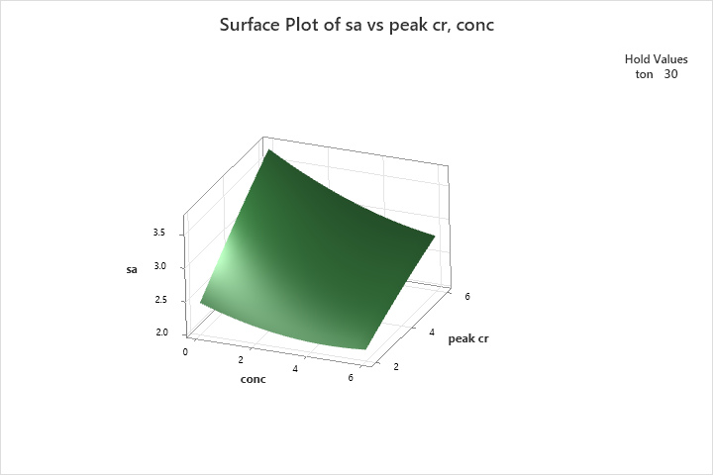
SURFACE PLOT OF SURFACE ROUGHNESS VS PEAK CURRENT, CONCENTRATION OF POWDER
By increasing concentration of chromium powder, surface roughness of the nickel based super alloy (Nimonic75) is decreased.
By increasing peak current with concentration of powder the surface roughness is increased.

Slide 13
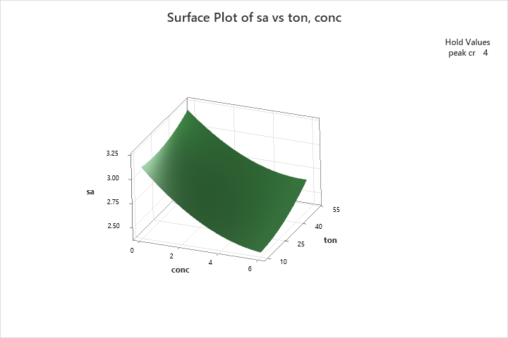
SURFACE PLOT OF SURFACE ROUGHNESS VS PULSE ON TIME(Ton), CONCENTRATION OF POWDER.
By increasing the concentration of chromium powder on nimonic75 super alloy results in decrease in surface roughness.
By increasing the pulse on time (Ton) with concentration of powder surface roughness increases.

Slide 14
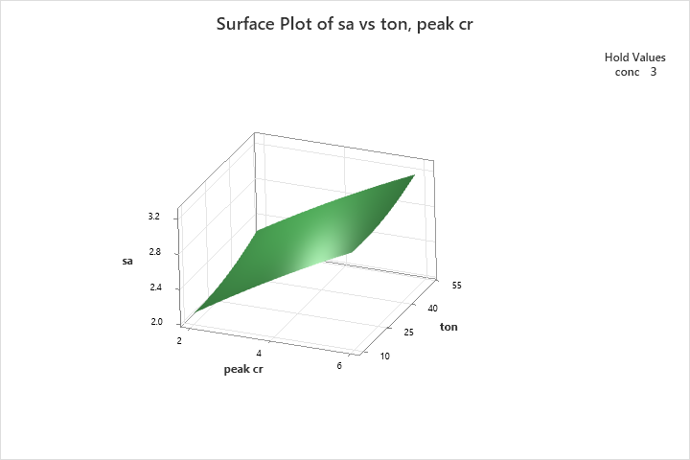
SURFACE PLOT OF SURFACE ROUGHNESS VS PULSE ON TIME(Ton), PEAK CURRENT.
When peak current is increased, surface roughness also increasing with peak current.
When pulse on time is also increased, there is small change in surface roughness.
It is slightly decreases and increasing.

Slide 15
MICRO HARDNESS VALUES:
Concentration of powder | Peak Current | Pulse on Time (Ton) | Hardness
0 | 2 | 30 | 258
0 | 4 | 10 | 292
0 | 4 | 50 | 303
0 | 6 | 30 | 311
3 | 2 | 10 | 315
3 | 2 | 50 | 330
3 | 4 | 30 | 342
3 | 4 | 30 | 346
3 | 4 | 30 | 351
3 | 6 | 10 | 361
3 | 6 | 50 | 388
6 | 2 | 30 | 393
6 | 4 | 10 | 402
6 | 4 | 50 | 436
6 | 6 | 30 | 501

Slide 16
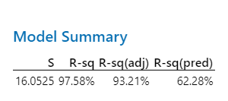
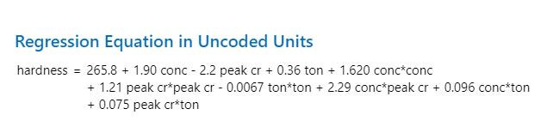
MODEL SUMMARY OF MICRO HARDNESS
REGRESSION EQUATION OF MICRO HARDNESS

Slide 17
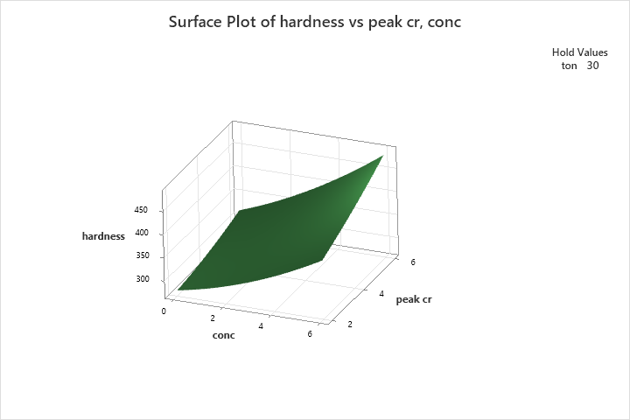
MICRO HARDNESS VS PEAK CURRENT, CONCENTRATION OF POWDER
By increasing concentration of chromium powder, Hardness of the nickel based super alloy(Nimonic75) is increased.
By increasing peak current with concentration of powder, Hardness is increasing.

Slide 18

MICRO HARDNESS VS PULSE ON TIME(Ton), CONCENTRATION OF POWDER
By increasing the concentration of chromium powder on Nimonic75 results in increase in Hardness.
By increasing pulse on time(Ton) with concentration of powder there is slight increase in Hardness.

Slide 19
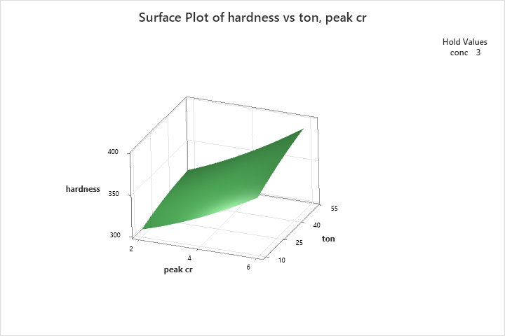
MICRO HARDNESS VS PULSE ON TIME (Ton), PEAK CURRENT
By increasing the peak current results in increase of Hardness.
By increasing the pulse on time(Ton) with peak current results in slight increase in hardness.

Slide 20
REFERENCES:
Bhattacharya, A., Batish, A. and Kumar, N. (2013), “Surface characterization and material migration during surface modification of die steels with silicon, graphite and tungsten powder in EDM process”.
Kansal, H.K., Singh, S. and Kumar, P. (2007), “Effect of silicon powder mixed EDM on machining rate of AISI D2 die steel”.
Singh, P., Kumar, A., Beri, N. and Kumar, V. (2010), “Influence of electrical parameters in powder mixed electric discharge machining (PMEDM) of Hastelloy”.

Slide 21
THANK YOU

